Slide 1
Fast Box approach to handle imbalanced dataset

Slide 2

Research Paper
Proposed two methodologies
Exact Box
Fast Box

Slide 3
Fast Box
Method to increase the instances in minority class
This method is cost sensitive learning approach.
Minority class is considered as the positive class
Majority class is considered as the negative class
First cluster the positive examples and then afterwards discriminate positives from negatives.
The discrimination is done by drawing a high dimensional axis-parallel box around each cluster and then adjusting each boundary locally to expand the initial boundary..
Three stages
Clustering Stage
Dividing space stage
Boundary expansion stage

Slide 4
Clustering Stage
Separate the minority class from majority class.
Cluster the minority class data into K clusters, where K is an adjustable parameter. Cross validation or other technique can be used to determine the number of clusters (K).
The decision boundaries are initially set as tight boxes around each of the clusters of positive examples.
The smallest enclosing parallel axes rectangle can be computed by taking the minimum and maximum of the minority class data in each cluster.
Cluster 1
l_{s,j,k}
u_{s,j,k}
J dimension
0,0
Maximum
l_{s,p,k}
Minimum
u_{s,j,k} = starting upper boundary of the j-th dimension of the k-th rectangle
u_{s,p,k}
l_{s,j,k} = starting lower boundary of the j-th dimension of the k-th rectangle
P dimension

Slide 5

2. Dividing space stage
The input space of the data is partitioned to determine which positive and negative examples will influence the placement of each decision boundary.
X_{l,j,k} = lower boundary of the j-th dimension of the k-th rectangle
(l_{s,j,k} + u_{s,j,k})/2
0,0
l_{s,j,k}
u_{s,j,k}
J dimension
l_{s,p,k}
u_{s,p,k}
P dimension

Slide 6

X_{u,j,k} = upper boundary of the j-th dimension of the k-th rectangle
(l_{s,j,k} + u_{s,j,k})/2
0,0
l_{s,j,k}
u_{s,j,k}
J dimension
l_{s,p,k}
u_{s,p,k}
P dimension

Slide 7
3. Boundary Expansion Stage
Each boundary is expanded by minimizing an exponential loss function. The solution for the decision boundary is analytical.
In this stage we discriminate between positives and negatives by creating a 1-dimensional classifier for each boundary of each box.

Slide 8

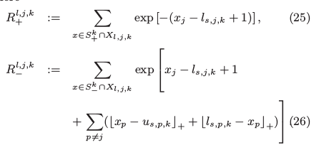
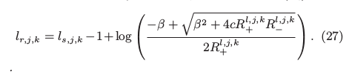
The objective function to be minimized
l_{r,j,k} = lower boundary of the j-th dimension
of the k-th revised box
c - weight for the majority class (c<1)
S₊^{k} - set of positive examples in the k-th cluster
S₋^{k} - set of negative examples in the k-th cluster
ß - a regularization parameter that tends
to expand the box
where

Slide 9

Adding the distances from x_{j} point to the l_{s,j,k} . Taking the distance in J dimension.
The factors of 1 added in the R^{l,j,k} exponent to ensure to avoid numerical problem., (R^{l,j,k} is at least exp(−1) > 0.3 )
(l_{s,j,k} + u_{s,j,k})/2
0,0
l_{s,j,k}
u_{s,j,k}
J dimension
l_{s,p,k}
u_{s,p,k}
X can be any point in this area
P dimension

Slide 10
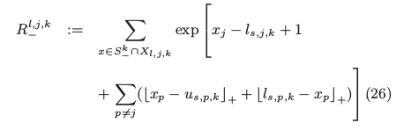
Adding the distance in J dimension and P dimension
X can be any point in this purple color area.
(l_{s,j,k} + u_{s,j,k})/2
0,0
l_{s,j,k}
u_{s,j,k}
J dimension
l_{s,p,k}
u_{s,p,k}
P dimension

Slide 11
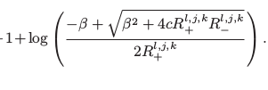
Boundary has moved its starting point by
0,0
J dimension
l_{s,p,k}
u_{s,p,k}
P dimension
l_{r,j,k}
l_{s,j,k}
u_{s,j,k}

Slide 12
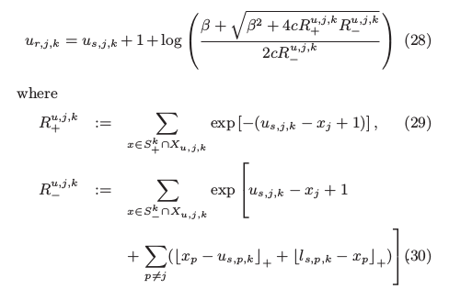
Equations to expand the upper boundary of j^{th} dimension

Slide 13
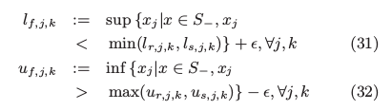
Determine the final boundary
l_{f,j,k} = final lower boundary of the j-th dimension of the k-th box
u_{f,j,k} = final upper boundary of the j-th dimension of the k-th box
Ɛ - small number
0,0
J dimension
l_{s,p,k}
u_{s,p,k}
P dimension
l_{r,j,k}
l_{s,j,k}
u_{s,j,k}
u_{r,j,k}

Slide 14
Final box after expanding in both the dimensions
J dimension
l_{f,p,k}
l_{s,p,k}
u_{s,p,k}
u_{f,p,k}
P dimension
l_{f,j,k}
l_{s,j,k}
u_{s,j,k}
u_{f,j,k}

Slide 15
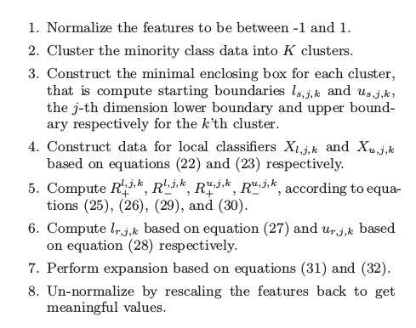
Algorithm

